Slide 1


Airbnb_by_zee
Tableau Project (Option 2)
AirBnB
File created on: 9/3/2023 6:45:15 AM
Zeynab Akolade

Slide 2
About AirBnB
Airbnb is a platform that allows homeowners to put up their properties for short, medium and long stays while getting some extra income. It was founded in August 2008 by Brian Chesky, Joe Gebbia, and Nathan Blecharczyk. It began as a way for them to rent out air mattresses in their apartment to attendees of a design conference in San Francisco.

Slide 3
Project/Goals
The goal of the project is to review the various Neighborhood, Host, Room Type, Price e.t.c in New York City with the use of visual representations.

Slide 4

Process
Connect to Data Source
Review the data and perform data cleaning if required
Create Worksheets and Dashboards
Formatting and Customization
Publish and Share
Save to document to pdf, PowerPoint or any document of interest

Slide 5
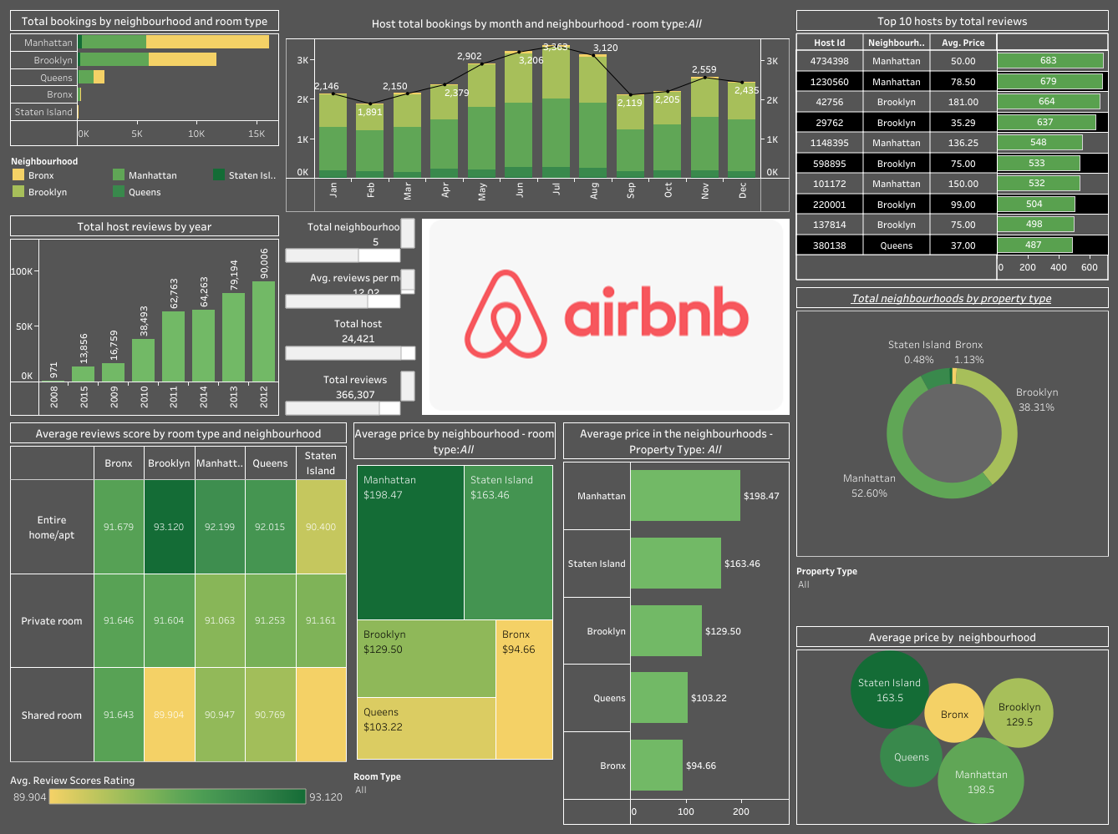

Slide 6
Results
Bar Chart (Host Bookings by Month and Neighborhood Group - Room Type):
Reveals that June records the highest number of bookings in the year.
Bar Chart (Top 10 Hosts by Total Reviews):
Highlights Host_id 4734398 in Manhattan as the host with the highest reviews, with an average price of $50.
Bar Chart (Total Bookings by Neighborhood Group and Room Type):
Indicates that Manhattan has the highest bookings across all neighborhoods.
Bar Chart (Total Number of Hosts by Year):
Shows that 2012 had the most reviews, possibly due to increased awareness of the business.
Bar Chart (Average Price by Neighborhood):
Points out that Manhattan has the highest average price.

Slide 7
Results
Pie Chart (Neighborhoods by Property Type):
Illustrates that Manhattan covers over 50% of the neighborhoods.
Highlight Table (Average Reviews Score by Room Type and Neighborhood):
Provides a quick overview of average reviews scores with color thickness.
Packed Bubbles (Average Price by Neighborhood):
Visualizes average prices, with Manhattan having the largest bubble, followed by Staten Island and Bronx with the lowest average prices.
Highlights (Total Hosts, Total Neighborhoods, Average Reviews per Month, Total Reviews):
Utilized to emphasize key figures such as the total number of hosts, neighborhoods in New York City, average reviews per month, and total reviews.

Slide 8
Challenges
Obtaining precise longitude and latitude coordinates from the available data is crucial in order to effectively generate geographical maps that accurately represent geographic locations and their spatial relationships.

Slide 9

Future Goals
Drill further down into Airbnb API to get API details so as to get the longitude and latitude of the various locations. This will help in the creation of geographical maps.
Analyse the data of another location like a province in Canada to compare what the business looks like in both countries.

Slide 10
Thank you.

